Slide 1
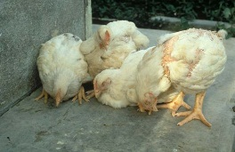
poultry diseases 2
fourth stage
شعار الكلية
chapter four Parasitic Diseases
lecture 9 External Parasites of Chickens
PART 2
Dr.Harith Abdulla
Department of Pathology and Poultry Disease
College of veterinary medicine university of basrah
University of Basrah- College of veterinary medicine- Department of Pathology and Poultry Disease

Slide 2
The most common external parasites are Lice,
Mites, Ticks and Fleas.
These are known as ectoparasites or external
Parasites as they live on the outside of the bird.

Slide 3
1-Lice:
Lice are long, narrow, tiny insects that move
quickly when you part a chicken′s feathers.
Unlike human lice, chicken lice don’t feed on
blood; they eat feathers or shedding skin cells.
There are several types of lice.. Includes:
Head lice, body lice, and lice that live on feather
shafts

Slide 4
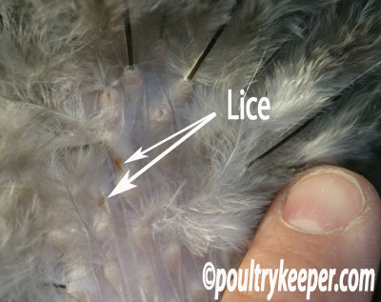

Slide 5
Transmission:
From bird to bird
1-by direct contact .
2-Via the hen house or litter.
Signs of Lice:
1-1 to 4mm fast moving lice at the base of the feathers.
Nits(louse eggs) stuck to the feather shafts below the
vent.
2- A drop in the number of eggs laid.
3-Irritation and scratching.
4-Over preening, feather loss, broken feathers, red, bare
bottoms.

Slide 6
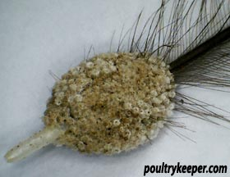
The photo shows louse eggs (called nits) firmly attached to the base of a feather, found below the vent. These will take up to 3 weeks to hatch.

Slide 7
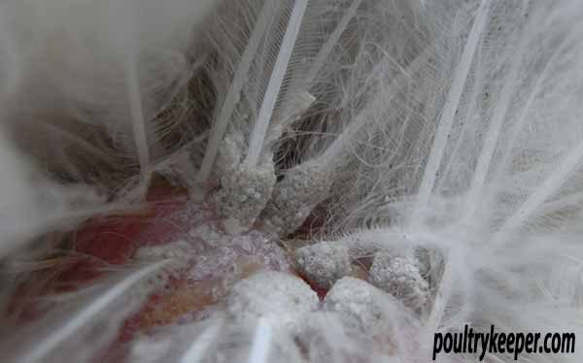
The photo shows an area below the vent which is typical when a hen becomes infested with lice.

Slide 8
Preventing Lice:
1-Dust baths and preening with carbaryl
powder .
Diatomaceous Earth can be added to the dust
bath which will help.
2-Avoid contact with other birds that have lice.

Slide 9
2-Mites:
Mites are very tiny rounded insects that can be seen only through a microscope and that will also bite humans.
They differ from lice in that they feed on the
blood of chickens.

Slide 10
The most common mites are :
1-Northern Fowl mite.
2-Tropical Fowl Mite.
3-Red Roost Mite.
4-Scaly Leg mite.
Transmission of Mites:
Mites can be transferred between flocks by crates,
clothing, and wild birds.

Slide 11
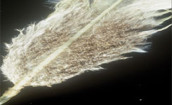
Mites and eggs along the feather shaft.

Slide 12
Signs of Mites:
1-Darkening of the feathers on white feathered birds due to
mite feces.
2-Scabbing of the skin near the vent.
3-Mite eggs on the fluff feathers and along the feather shaft
4- Congregations of mites around the vent, ventral
abdomen, tail, or throat.
5-Since mites congregate around the ventral region, they
can also reduce a rooster’s ability of successful matings.
6- Anemia

Slide 13
Treatment of lice and mites:
1-Ivermectin: Drops on the back of the neck.
2-Powders containing the Pyrethrium.
3-Organic powders.
4- Diatomaceous Earth.

Slide 14
3- Ticks:
The most important tick is the soft tick. Ticks also
feed on the blood of chickens .They feed for short
periods of time on chickens and spend the rest of
their time in crevices and cracks.

Slide 15
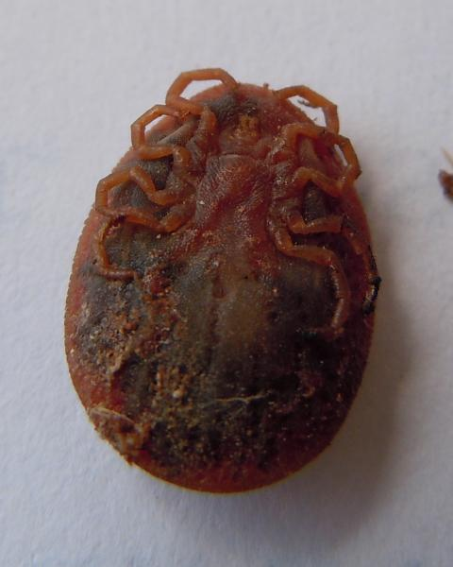
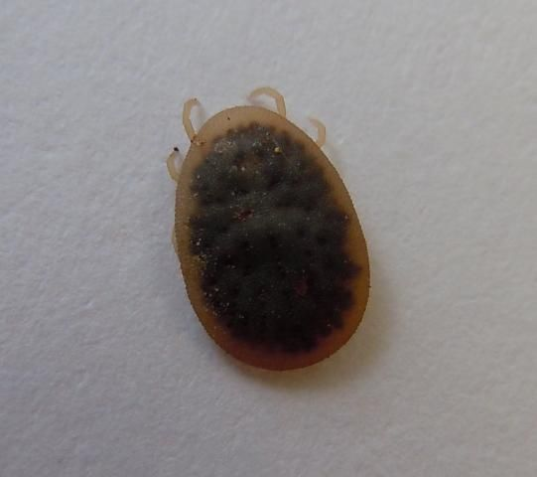

Slide 16
Signs of Ticks:
1-Ticks cause anemia, weight loss, decrease egg
production, and general weakness in chickens.
2-They can cause paralysis and transmission of
spirochaetosis( diarrhea).

Slide 17
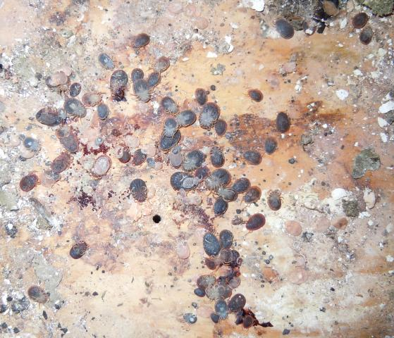

Slide 18
Control of Ticks:
1-Ticks are difficult to be controlled.
2-Treat the surroundings.

Slide 19
4-Fleas:
There are many kinds of fleas that infect poultry,
the most common type is the stick tight flea. They
also feed on the blood of chickens.
• They are source of irritation.
• They multiply in the bodies of dead chickens
and in the droppings.

Slide 20
Stick-tight Fleas
1- Stick-tight fleas are the smallest type of fleas.
2-Lay their eggs around the eyes and wattles.
3-Causing nodules ,skin irritations and ulcerations.
4-Severe infestations may lead to blindness.
5-It is often congregate into groups of at least 100
fleas.

Slide 21
Signs of Stick-tight fleas:
1-Small brown dots clinging to or embedded into the fleshy portions of the head.
2-Inflammation of the head.
3-Decrease egg production and feed efficiency.
4-Anemia.
5-Secondary bacterial infections may develop.
6-Death of young birds may occur.

Slide 22
Treatment:
1-Carbaryl (Sevin®) to dust the litter and facilities;
2-Removal of the fleas .
Prevention:
Raising birds in wire cages at least three feet
above the ground .

